Slide 1
Introduction to Scala programming

Slide 2
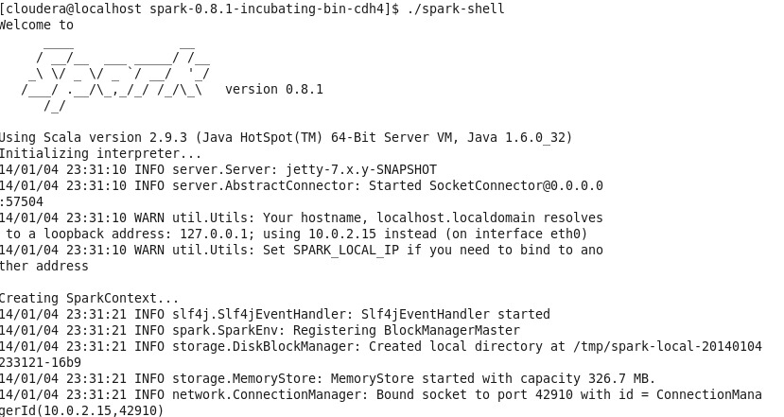
Scala
Before going to more detail on how to program Spark we will first give a small course on how to program Scala
The scala or spark interpreter is the best way to learn Scala
./spark-shell

Slide 3
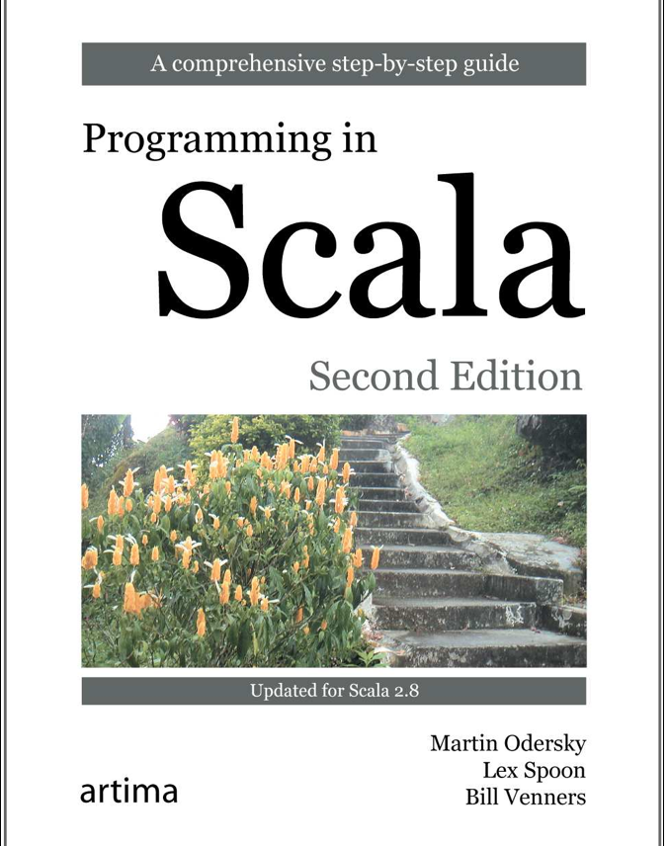
Book
Very nice book on Scala.
I totally recommend buying this book if you want to learn more about Scala.

Slide 4
Scala
Scala stands for “scalable language”
Designed to grow with the demands of its users
Good for both small and large systems
Blend of object-oriented and functional programming concepts.
Functional: allows you to build interesting things quickly
Object-oriented: easier to structure larger systems and to adapt them to new demands.
Runs on the standard Java platform
Interoperates seamlessly with all Java libraries
Java objects can be easily used within Scala

Slide 5
Statically Typed
Scala is statically typed and very very good at inferring type.
Scala almost looks like it is dynamically typed.
Scala has the best of both worlds
Easy to write since you do not need to write much type information
Very good at inferring type
Example 1
in Java 1.5: Pair p = new Pair<Integer, String>(1, "Scala");
in Scala: val p = new MyPair(1, "scala");
Example 2
In Scala
var x: Int = 7
var x = 7 // type inferred
val nums = Array(1, 2, 3)
Since it is statically typed the compiler will pick up stupid things like the following
E.g. var z = false
z + 3
The compiler will not allow this to happen since an integer can not be added to a Boolean.

Slide 6
Basics
scala> 1 + 2
res0: Int = 3
Semicolons at the end of statements are optional!
scala> res0 + 4
res1: Int = 7
The result of an expression is stored in a variable called res0, res1, res2 etc.
The result variable can then be used by another expression.
scala> println(“Hello, world!”)
Hello, world!

Slide 7
Variables
var x = 7 // can be modified
X = 20 // ok allowed
val y = “hi” // read-only
y = “there” // error can not modify a read only variable
Variables declared using var can be modified
Variables declared with val are read-only

Slide 8
Scripts
You can write scripts like the following which takes a command line argument
println(“Hello, “ + args(0) + “!”)
Then run the following at the command line to run the script (assuming the script is stored in the file called helloarg.scala)
$ scala helloarg.scala planet
The output would be:
Hello planet

Slide 9
Arrays
val greetStrings = new Array[String](3)
greetStrings(0) = “Hello”
greetStrings(1) = “, “
greetStrings(2) = “world!\n”
for (i <- 0 to 2)
print(greetStrings(i))
Note arrays are indexed using () instead of the usual []
Arrays in Scala are mutable meaning you can modify the contents of the array without needing to create a new Array.

Slide 10
Lists
Lists are preferred in comparison to arrays in Scala
Functional programming: methods should not have side effects (functions should not mutate collections passed into it)
This makes methods more reliable
In contrast, Scala array is a mutable sequence of objects
val oneTwo = List(1, 2)
val threeFour = List(3, 4)
val oneTwoThreeFour = oneTwo ::: threeFour
println(oneTwo + “ and “ + threeFour + “were not mutated.”)
println(“Thus, “ + oneTwoThreeFour + “ is a new list.”)
The output is
List(1, 2) and List(3, 4) were not mutated
Thus, List(1, 2, 3, 4) is a new list.
The ::: is used to concatenate two lists.

Slide 11
Lists
Lists are by default immutable. So when you add something to a list Scala will create a new list.
You can mutate lists inplace by using a list from the mutable collection.

Slide 12
Add to front of list instead of append to the end
The following discussion relates to the default immutable lists.
Adding to the front of a list is a constant cost operation since just involves creating a new list with a head and then attaching the old list behind it.
However, appending to the end of the list costs linear time since it involves copying the entire list to the new list and then adding the last one to the end.
val twoThree = List(2, 3)
val oneTwoThree = 1 :: twoThree
println(oneTwoThree)
Output
List(1, 2, 3)
The above shows how to add an item at the beginning of a list
val twoThree = List(2, 3)
val twoThreeOne = twoThree :+ 1
Println(twoThreeOne)
Output
List(2, 3, 1)
The above shows how to append an item at the end of a list. Slow.

Slide 13
Use Tuples
Effectively just objects with no field names
Just data!
val pair = (99, “Luftballons”)
println(pair._1)
println(pair._2)
The following is outputted
99
Luftballons
The ._1 and ._2 are used to refer to the first and second members of the pair respectively.
Tuples can have an arbitrary number of elements, not just 2 as in the example above.

Slide 14
Maps
val romanNumeral = Map(1 -> “I”, 2 -> “II”, 3 -> “III”)
println(romanNumeral(1))
Output:
I
The above shows how to use an immutable map.
By default maps in Scala are immutable.
However, the above immutable map can not have any items added.
val treasureMap = scala.collection.mutable.Map[Int, String]()
treasureMap(2) = “Find big X on the ground.”
println(treasureMap)
Output:
Map(2 -> Find big X on the ground.)
The above shows how to use a mutable map
Mutable maps allow you to insert elements

Slide 15
Sets
val jetSet = Set(“Boeing”, “Airbus”)
println(jetSet.contains(“Cessna”))
Output:
false
The above shows an example using a set.
By default sets are immutable and so you can not add any elements
val jetSet = scala.collection.mutable.Set("Boeing", "Airbus") jetSet += "Lear”
println(jetSet)
Output:
Set(Airbus, Boeing, Lear)
The above shows an example inserting into a mutable set.

